Slide 1

Signing Third Party Agreements with DocuSign
You will learn how to:
Sign Third Party Limited License Agreements with DocuSign
Understand DocuSign-related email notifications
For Third Party Vendors
Notes:
This module demonstrates how to sign Third Party Limited License Agreements with DocuSign, as well as how to understand DocuSign-related email notifications.

Slide 2
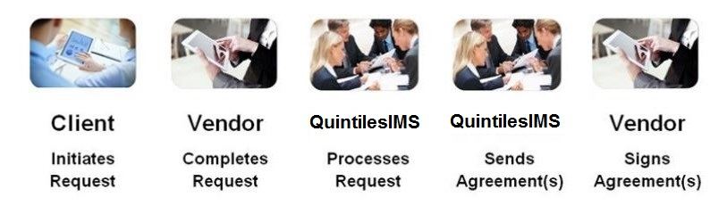
Third Party Access Requests
Process Flow
IQVIA
IQVIA
Notes:
On this page we see the process flow for Third Party Access Requests. In order for your company to obtain access to data offerings licensed by our mutual client, your company must enter into a third party limited license agreement based upon the information provided by you and our mutual client.
[1] This module demonstrates how to sign third party limited license agreements, also known as Third Party Agreements, with DocuSign.

Slide 3
DocuSign
Purpose
Facilitates exchange of contracts and signed documents
DocuSign manages the Third Party Limited License Agreement signature process:
Attaches the agreements within a DocuSign “Envelope” and sends an email
The recipient has the ability to sign the agreement electronically, transfer signature authority, or sign a hard copy
  Electronic signatures enhance processing time
A digital copy of the completed agreement is forwarded electronically to the appropriate parties
Ensure @docusign.net is permitted via your company’s firewall
Notes:
DocuSign manages the Third Party Limited License Agreement signature process in three steps. In the first step, the agreements are attached within a DocuSign Envelope. An email is sent that references the envelope to the designated authorized signer. In the second step, the recipient has the ability to sign the agreement electronically, transfer signature authority or sign a hard copy. Using electronic signatures significantly enhances processing time. In the third step, a digital copy of the completed agreement is forwarded electronically to the appropriate parties.
In order to receive all emails from DocuSign, please ensure at-docusign-dot-net (@docusign.net) is permitted via your company’s firewall for each individual email account.

Slide 4
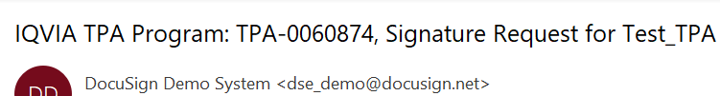
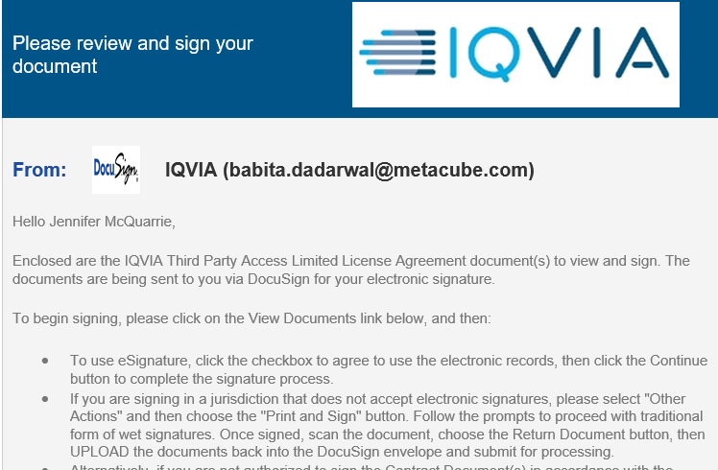
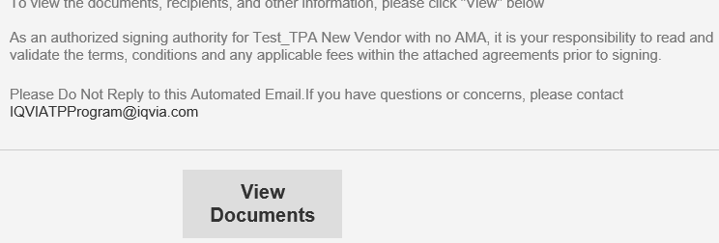
How to Sign Third Party Limited License Agreements with DocuSign
Email Notification
Notes:
On this page we see a sample of a signature request email as it might appear in your inbox.
[1] The subject will include the words Signature Request.
[2] When you open the email, simply click on the View Documents button to review the Third Party Limited License Agreement.
Note: The View Documents button may appear as a simple hyperlink depending on your email service/settings.

Slide 5
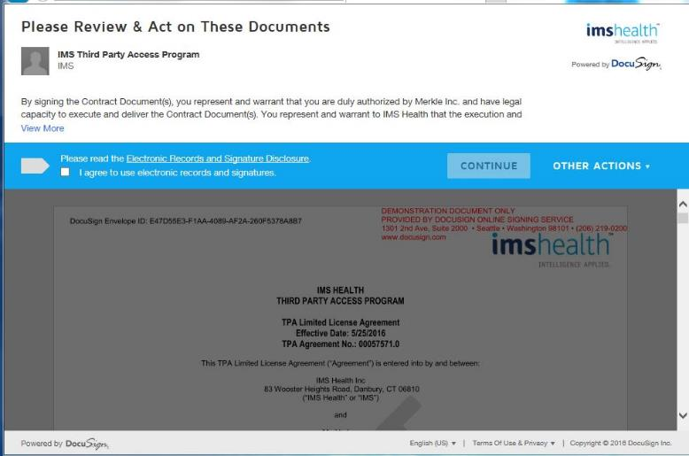
DocuSign Interface
Select each highlighted section to learn more
Understand that you represent and warrant that you are duly authorized by your company to sign this agreement
IQVIA
Click to check that you agree to sign electronically and then click Continue. This agreement will only appear the first time you sign.
The Other Actions menu allows you to transfer signature authority and use Pen-and-Paper signatures
A draft copy of the Third Party Limited License Agreement
Notes:
On this page we see the DocuSign Interface that opens once view documents is selected. This interface allows you to complete various actions related to signing a Third Party Limited License Agreement. Select each highlighted area called out in red to learn more. Once you have completed this activity, please click outside the red boxes to resume this presentation.

Slide 6
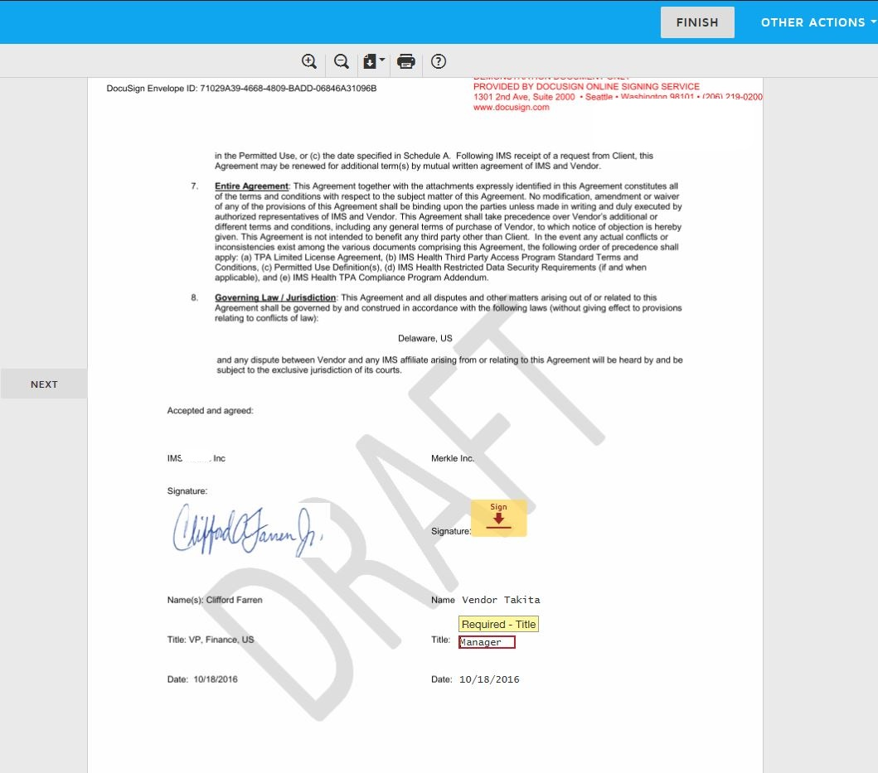
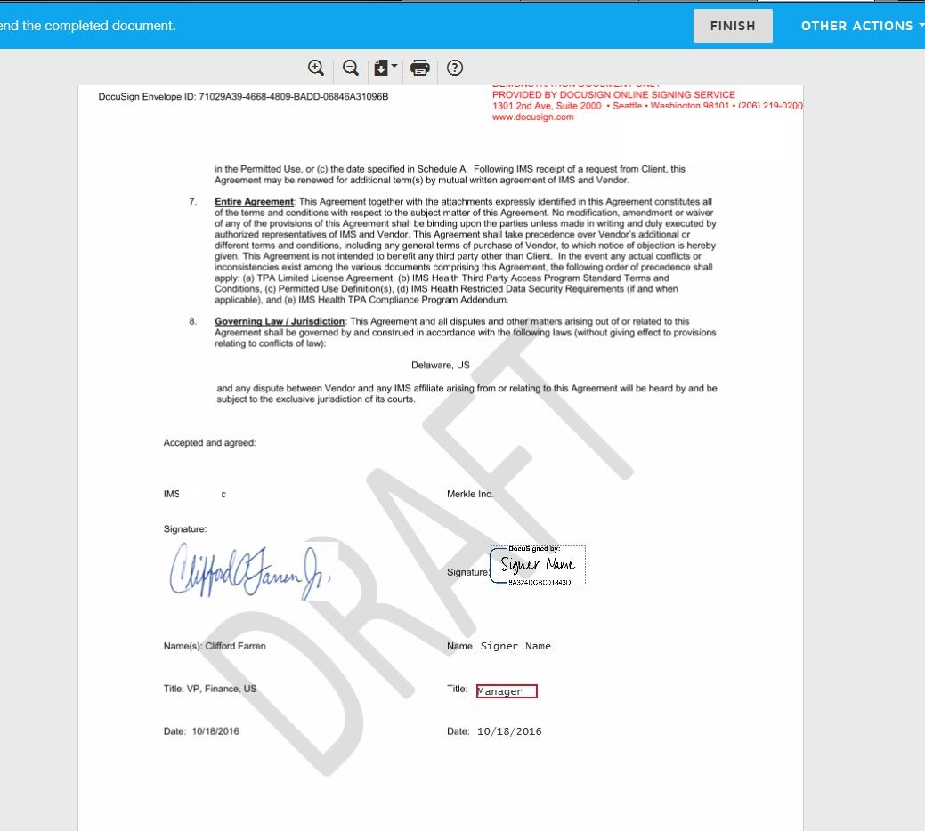
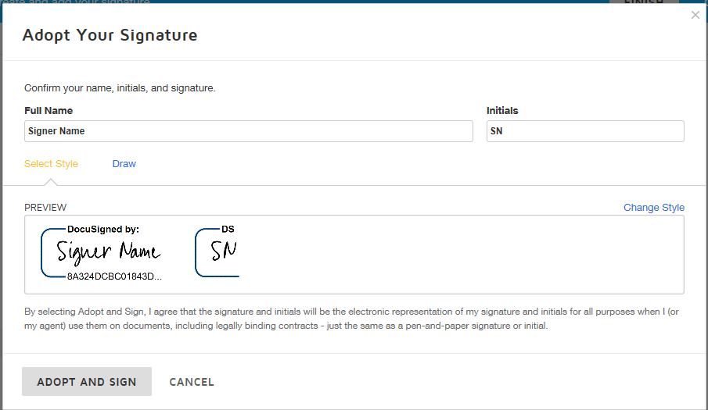
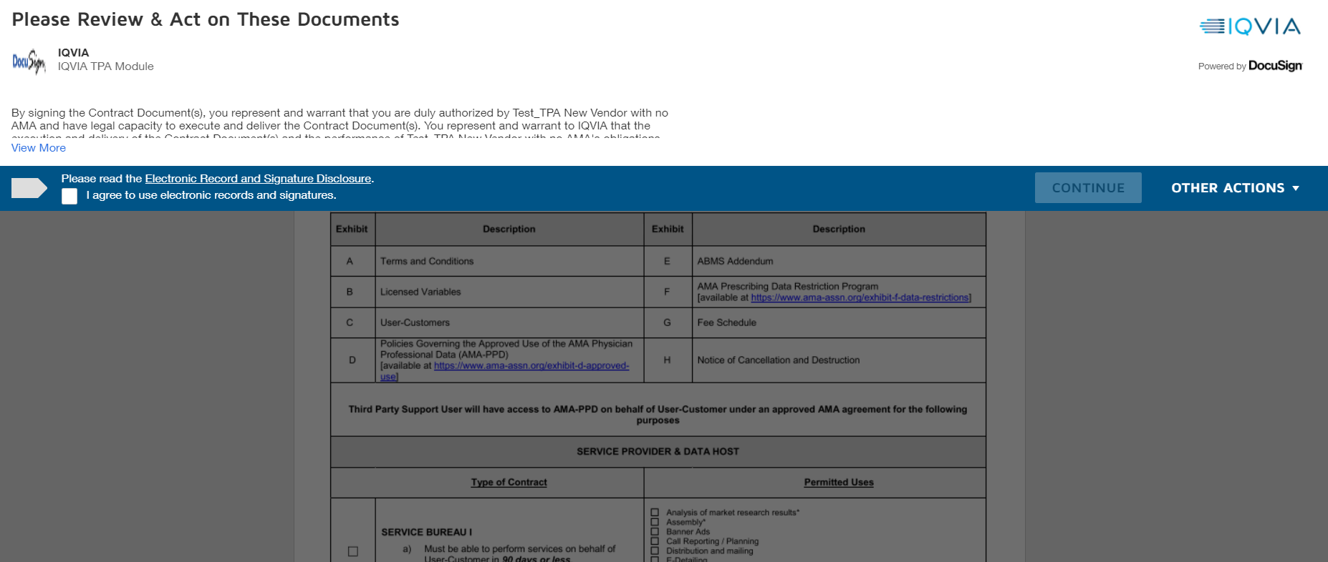
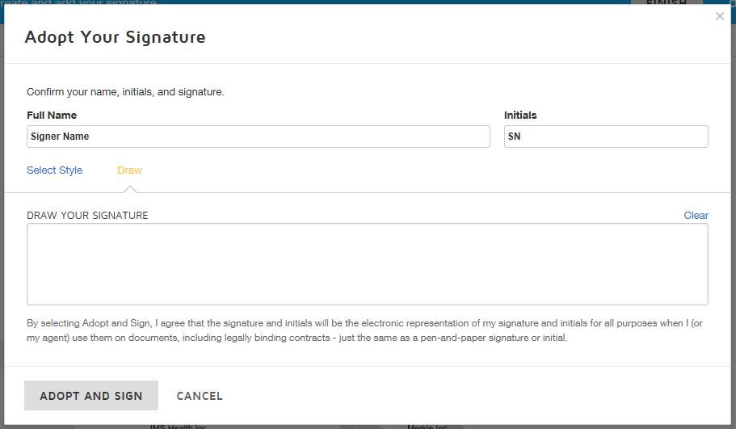
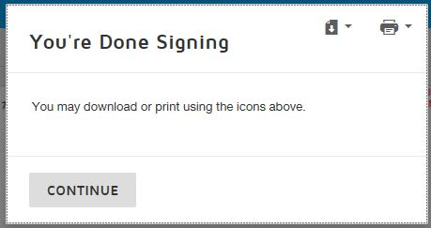
Signing Electronically
Notes:
The easiest and quickest way to sign documents in DocuSign is by signing electronically. The first time you complete this process, you will need to agree to use electronic records and signatures by clicking on the check box. Once you check the box, the Continue button, called out in red here, becomes available.
Click the Continue button and,
[1] The Third Party Agreement opens. Use the scroll bar to review the entire document for accuracy.
Once you are ready to sign, use the Next button to return to the signature block and select the Sign button.
[2] This prompt appears which allows you to electronically sign with a default signature provided by the system.
[3] You can change the signature style or
Draw a signature with your mouse.
[4] Once the signature meets with your satisfaction, click the Adopt and Sign button. Please be aware that if there is more than one signature block, you will need to use the Next button to sign each one individually. You may also be prompted to fill in your title. Follow the prompts.
The Finish button is activated once all signatures are complete.
[5] Once the signature process is finished, this message will appear.

Slide 7
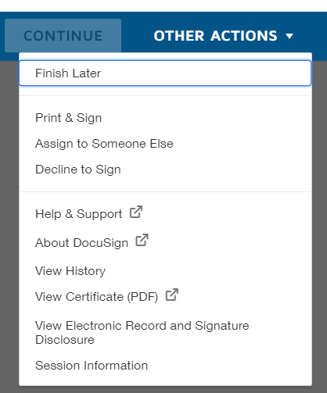
“OTHER ACTIONS” Menu
Options
Select ‘OTHER ACTIONS’ tab to…
Finish Later
Print & Sign
Assign to Someone Else
Decline to Sign
Notes:
[1] On this page we see the Other Actions menu.
[2] We can use this menu to transfer signature authority if needed, or
[3] Manually sign an agreement using a pen-and-paper signature. If your country does NOT allow electronic signatures, you MUST use this option.

Slide 8
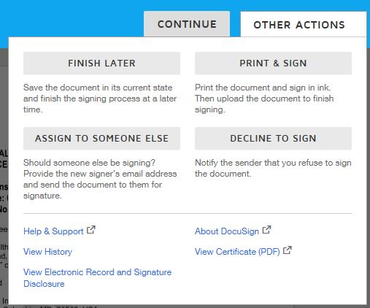
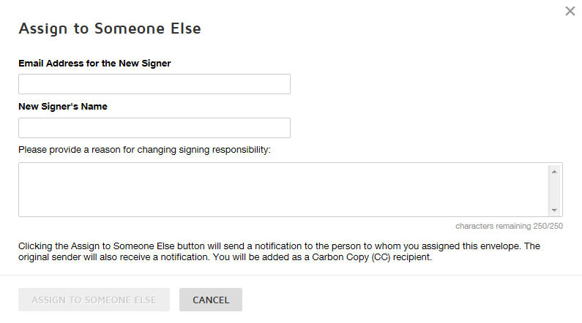
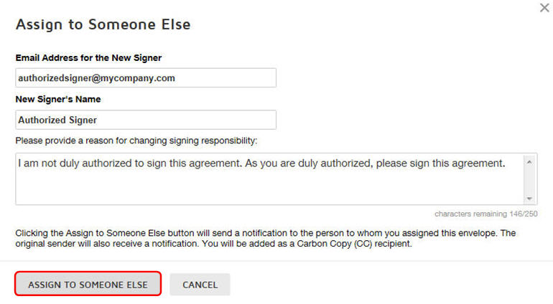

Transferring Signature Authority
Need to ‘Assign to Someone Else’?
Select ‘OTHER ACTIONS’ tab to…
Finish Later
Print & Sign
Assign to Someone Else
Decline to Sign
Email notifications will be sent to:
  The person to whom you assigned this envelope
  The original sender
  You as a Carbon Copy (CC) recipient
Notes:
To transfer signature authority,
[1] use the Assign to Someone Else option found on the Other Actions menu. This prompt will appear.
[2] Provide the email address, name of the authorized signer.
[3] You can optionally provide the reason for the transfer. Note: The text you enter in this box will be included in the email notification to the assigned signer, so if necessary, use this box to inform that person why you require them to sign.
When you are ready, select Assign to Someone Else to forward this signature request to the correct signer.
[4] If successful, the message shown will appear.
Email notifications will be sent to:
The person to whom you assigned this envelope
The original sender
You as a Carbon Copy (CC) recipient

Slide 9
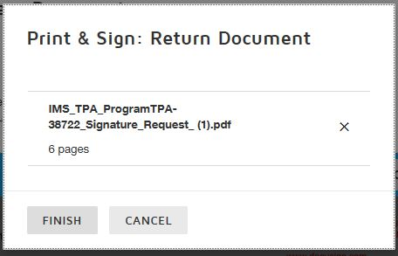
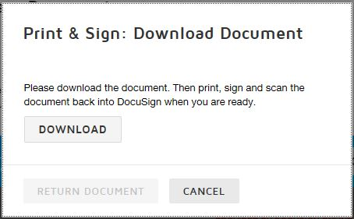
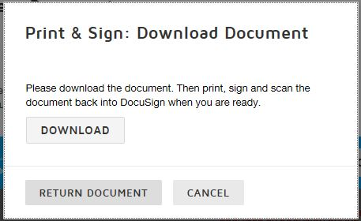
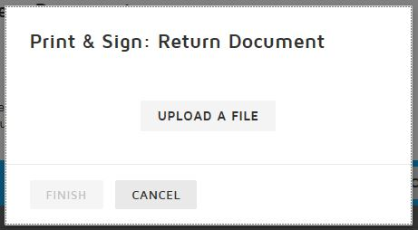
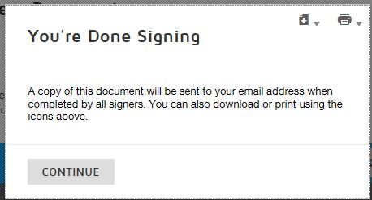
Signing with Pen-and-Paper
Notes:
To sign a hard copy of the agreement with a pen-and-paper signature, select the Print & Sign button from the Other Actions menu. This prompt will appear.
[1] Click Download to save a local copy of the agreement to your computer. Print a hard copy and sign it. Scan the signed copy and save it as a file to your computer.
[2] Click Return Document and select the file that contains the signed copy of the agreement.
[3] Click Upload a File,
[4] and then click Finish to complete the pen-and-paper process for this document.
[5] Agreements signed using the Pen-and-Paper method will require additional processing time as our company must review and validate the final document. We may contact you to resolve any discrepancies that may be found.

Slide 10


DocuSign Email Notifications
Notification of Completion
Completed
Other Email Notifications
  Carbon Copies
Notes:
Once the signature process is completed, the authorized signer will receive a “Completed” email notification. The signed copy of the Third Party Limited License agreement will be attached, or you can use the View Document button within the email to view the signed document via DocuSign.
[1] There are other DocuSign notifications you might receive, one of which is a Carbon Copy of a Signature Request. If you are the recipient of a Carbon Copy, you will not be able to sign the document. You can tell you are the recipient of a carbon copy in several ways:
[2] First, the words “Carbon Copy” will appear at the top of the Signature Request Notice. Depending on your email service and settings, these words may be in simple blue type near the top of the document.
Second, when you select the View Documents button from the email notification…
[3] The Continue button is located at the bottom of the screen, and the options described earlier in the module via the Other Actions button will not be available. In addition, when continue is clicked, the words In Process will appear over the agreement, and there will be no Sign Here tab.

Slide 11
What Happens Next?
Process Flow
IQVIA
IQVIA
Notes:
Once the Third Party Agreement is signed, the final step of the process flow is completed. On this page we see a graphic representing the process flow from request initiation to contract signatures. After the agreement is signed and, if needed, validated by our company, data release notifications are sent to both the client and the vendor.

Slide 12
Third Party Access Program Support
Reporting Questions and Issues
Please email IQVIATPProgram@iqvia.com
For a question include:
  Your name
  Contact Information
  Country
  Your Question
For an issue, include:
  Your name
  Contact Information
  Country
  Detailed description of steps taken
  Screenshot(s) of the error, if possible
More information and training related to DocuSign functionality can be found on their web site at https://www.docusign.com/support/classic
Notes:
For any questions pertaining to the third party access program, please send an email to the address shown. Please include in the email your name, contact information, the country you are located in, and your question. If reporting an issue, please also include a description of the steps taken leading up to the issue and, whenever possible, screen shots of the error that occurred.

